Slide 1
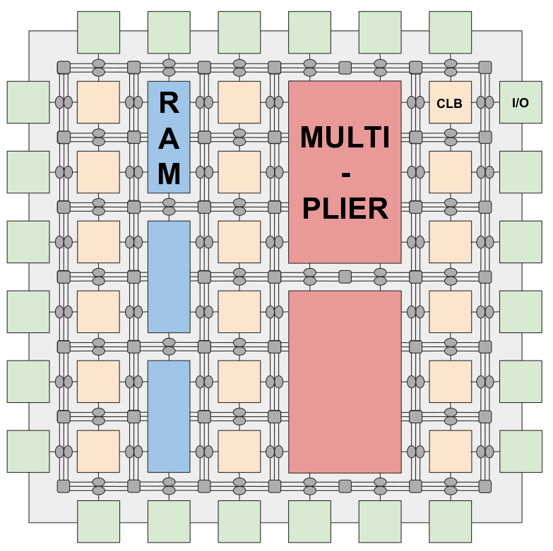
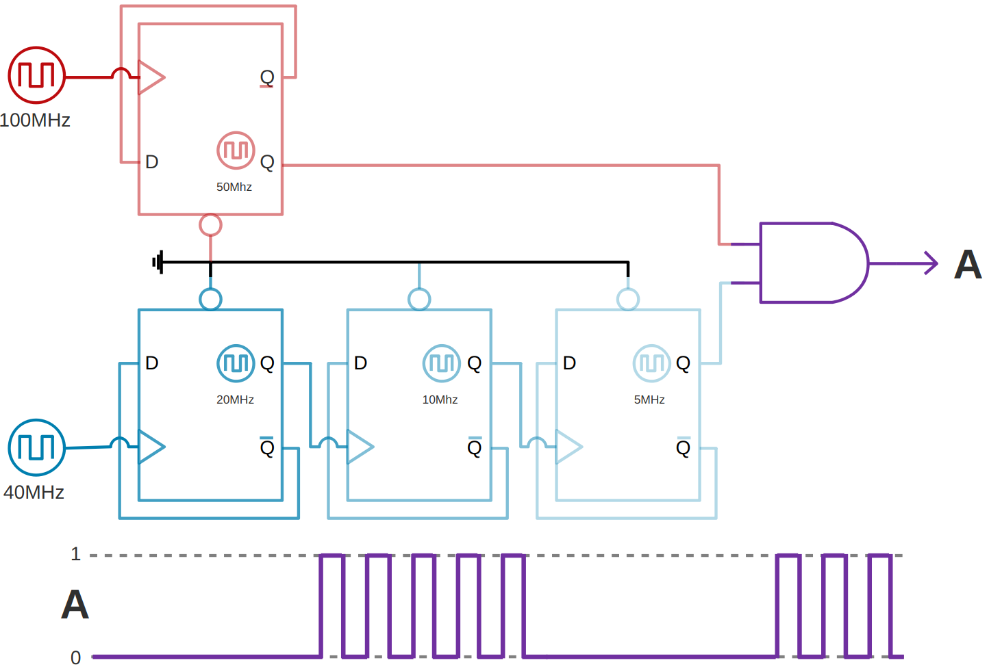
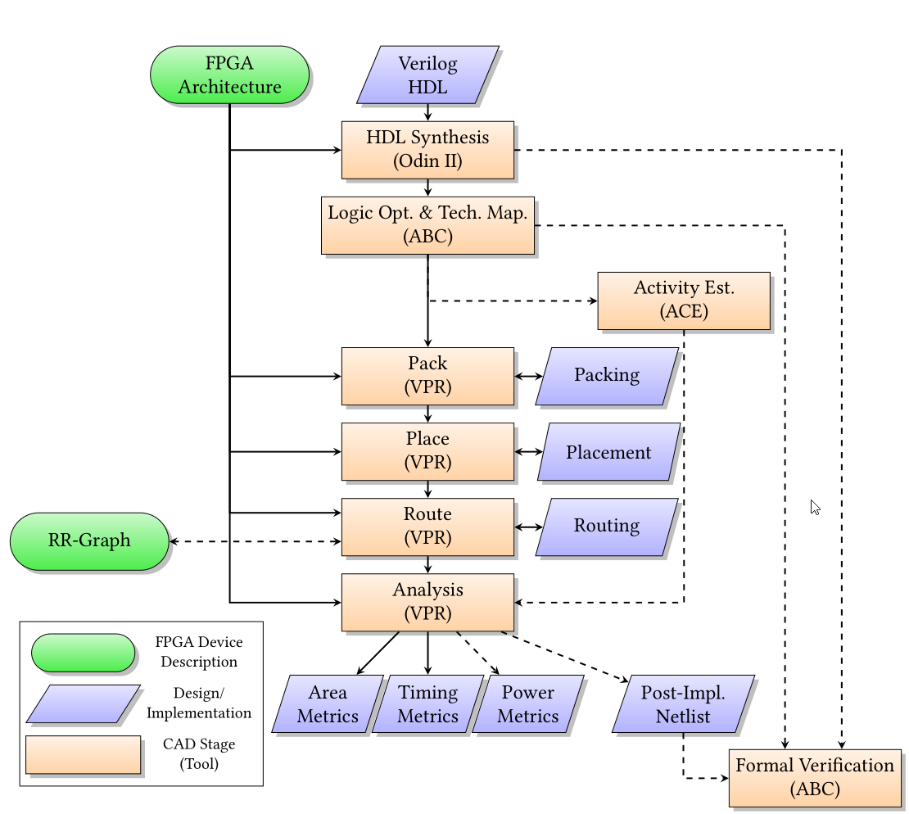
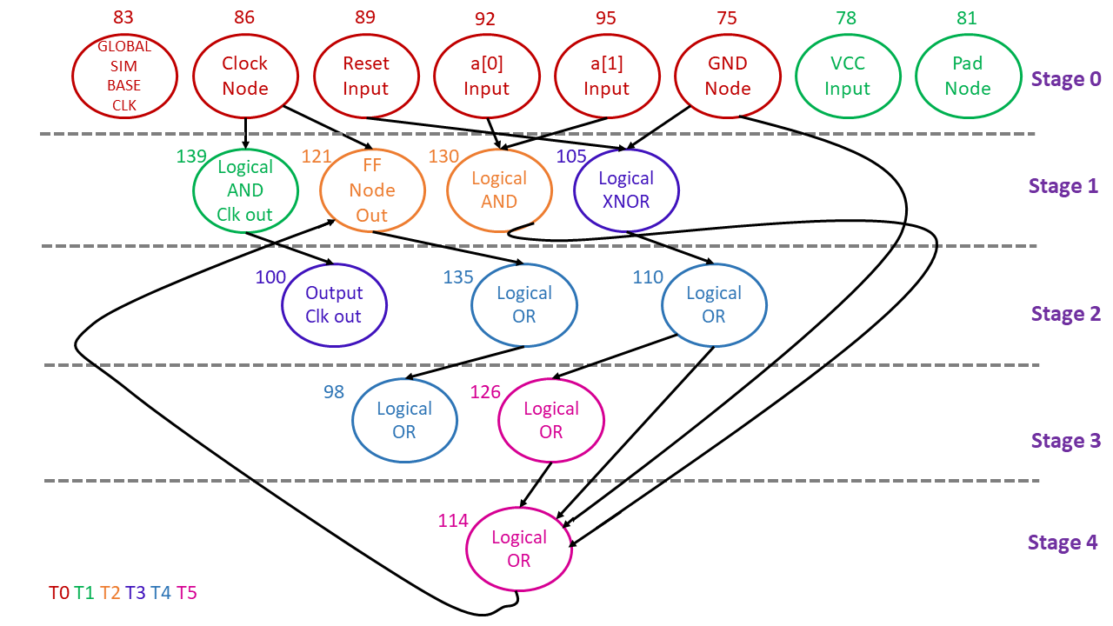
Improved Synthesis and Simulation for FPGAs
ODIN II for VTR 8.0 and Beyond
Aaron G. Graham, Jean-Philippe Legault,
Maria Patrou, Kenneth B. Kent
Faculty of Computer Science, University of New Brunswick
{aaron.graham, jlegault, maria.patrou & ken}@unb.ca
Improving ABC Logic Optimization and Technology Mapping
We updated the source from ~2012 ABC to ~2018 ABC.
Significant Gains in several important metrics:
Multi-Clock and Clock Domain Support for
Synthesis, Simulation and Optimization
ABC optimizer does not support more than a single clock domain.
How do we fix this?
We iterate through and expose one clock domain at a time to the ABC optimizer by blackbox all the other domains.
Multi-threaded Simulation Optimization
Improve the multi-threaded circuit simulation via:
Inter-cycle parallelism
Intra-cycle parallelism
Memory dictionaries
Field-Programmable Gate Arrays (FPGAs)
Flexible and re-programmable hardware.
It is composed of:
Logic Elements
Routing elements: Interconnects and Input/Output pins
Verilog-to-Routing (VTR) FPGA CAD Toolset
Turns Synthesizable Verilog Hardware Description Language (HDL) into Routable Circuitry

