Slide 1
Optimization Models
Mathematical optimization models usually contain
an objective (what to do)
constraints (the rules that must be followed).
Also referred to as programming models
Example objective: maximize profit for the week ($150 per unit).
Example constraint: maximum of 40 hours for production (each unit takes 8 hours).

Slide 2
Model Inputs
Controllable inputs are those over which we have influence (in this case X), and are also referred to as decision variables. The decision alternatives are the different values for these inputs or variables. The optimal alternative is the set of input values that
is feasible (i.e. satisfies the constraints)
best meets the objective
Uncontrollable inputs are those over which we have no influence

Slide 3
Modeling Example
CrossChek would like to set up displays in some of its retail stores for two new lines of hockey sticks. The company has designated two employees to work on setting up these displays, with employee A having up to 12 hours available and employee B having up to 8 hours available. They need to figure out the optimal number of stores in which to set up each display.
It is expected that each display of the first stick will bring in $3K in new profit, the second $2K
It takes employee A 4 hours to set up each display for the first type of stick
Each display for the second type of stick requires 1 hour from employee A and 2 hours from employee B.

Slide 4
Linear Programming
This particular model is a linear programming model, or linear program.
A mathematical model in which the objective and the constraints are described using linear functions (functions in which each variable appears in a separate term and is raised to the first power. A function with n variables will create a line in n-dimensional space).
“Programming” is not meant in the sense of computer programming, but rather that (optimal) decisions must be made within the model. Thus the act of describing and solving a decision problem with linear objective and constraint functions is referred to as linear programming.

Slide 5
Back to CrossChek Manufacturing
Consider two high-end hockey sticks, A and B. $150 and $200 profit are earned from each sale of A and B, respectively. Each product goes through 3 phases of production.
A requires 1 hour of work in phase 1, 48 min in phase 2, and 30 min in phase 3.
B requires 40 min, 48 min and 1 hour, respectively.
Limited manufacturing capacity:
phase 1 1000 total hours
phase 2 960
phase 3 1000
How many of each product should be produced?
Maximize profit
Satisfy constraints

Slide 6
LP: Production Planning
Three products P1, P2, P3, two machines M1 & M2.
Machine capacities: 8 & 9 hours, respectively.
The products sell for $20, $15, and $17, respectively.
Production costs: M1: $120 per hour, M2: $90 per hour.
Processing times of the products on the machines (minutes):
P1 P2 P3
M1 3 5 4
M2 6 1 3
Need to maximize profit

Slide 7
LP: Employee Scheduling
Allocate employees to shifts. Shifts start every four hours at 0600 hrs, 1000 hrs, 1400 hrs, etc. Each shift lasts 8 hours. Minimize the total number of employees required.
Personnel requirements during 4-hour time slots:
Shift | 0600 −1000 | 1000 −1400 | 1400 −1800 | 1800 −2200 | 2200-0200 | 0200 −0600
Minimum required number of employees | 17 | 9 | 19 | 12 | 5 | 8

Slide 8
LINDO
Windows software for solving linear programming models
http://www.lindo.com/
Download and install “Classic LINDO”
Select “Demo Version” when prompted

Slide 9
LINDO
Two sections:
Objective – Prefixed with “Maximum” or “Minimum” (“Max” or “Min”)
Constraints – Prefixed with “Subject to” (“st”)
Operators:
Only +, -, <, > or =
Not case sensitive
Once the model is entered, click the “Solve” menu, then the “Solve” command

Slide 10
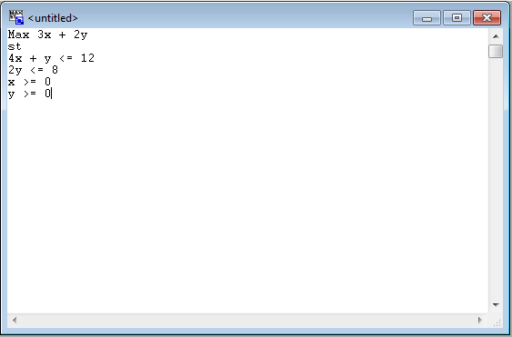
LINDO Input

Slide 11
LINDO Output
Objective function value given
The optimal value of the objective function
Solution given
Under the “VALUE” heading for each variable
Ignore everything else for now

Slide 12
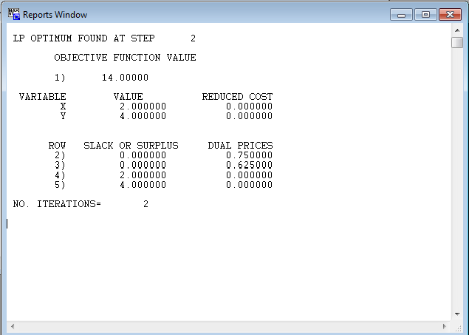
LINDO Output

