Slide 1
Waiting Lines
CrossChek Sporting Goods’ Golf Division gets requests-for-quotes for custom-made golf clubs at a rate of about 4 per hour. Each of these requests is individually assessed by a sales clerk, who then answers with a quote. It takes a clerk an average of 10 minutes to answer a request for a quote.
What is the probability of 3 requests arriving in an hour?
What is the probability of at least 2 requests arriving in an hour?
What is the probability that it will take less than 10 minutes to process a quote request?
What is the probability that it will take between 10 and 12 minutes to process a quote request?

Slide 2
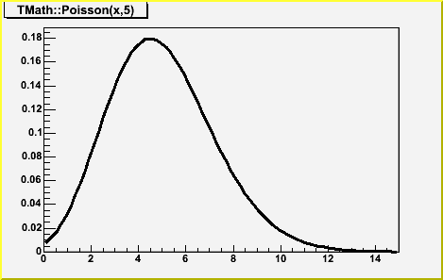
Poisson Distribution
Models distribution of numbers of arrivals during a specified period
Few possible outcomes less than the mean, but higher likelihoods

Slide 3
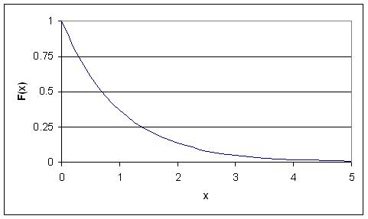
Exponential Distribution
Models distribution of service times
Low outcomes more likely, very high outcomes still possible

Slide 4
Back to CrossChek’s Problem…
CrossChek Sporting Goods’ Golf Division gets requests-for-quotes for custom-made golf clubs at a rate of about 4 per hour. Each of these requests is individually assessed by a sales clerk, who then answers with a quote. It takes a clerk an average of 10 minutes to answer a request for a quote.
What is the probability of 3 requests arriving in an hour?
What is the probability of at least 2 requests arriving in an hour?
What is the probability that it will take less than 10 minutes to process a quote request?
What is the probability that it will take between 10 and 12 minutes to process a quote request?

Slide 5
Back to CrossChek’s Problem…
CrossChek Sporting Goods’ Golf Division gets requests-for-quotes for custom-made golf clubs at a rate of about 4 per hour. Each of these requests is individually assessed by a sales clerk, who then answers with a quote. It takes a clerk an average of 10 minutes to answer a request for a quote.
What is the probability of 3 requests arriving in an hour?
0.195
What is the probability of at least 2 requests arriving in an hour?
0.909
What is the probability that it will take less than 10 minutes to process a quote request?
0.63
What is the probability that it will take between 10 and 12 minutes to process a quote request?
0.07

Slide 6
More Questions
What is the average number of requests waiting to be processed?
What is the average number of requests in the system?
What is the average waiting time?
What is the average time spent in the system?
What is the probability that a request needs to wait before being processed?
What is the probability that there are no requests in the system?
What is the probability that there are 4 requests in the system? 7?

Slide 7
Fomulas
Question | Notation | Formula
Average number of customers in the waiting line | L_{q} | L_{q} = λ²/[µ(µ - λ)]
Average number of customers in the system | L | L = L_{q} + λ/μ
Average waiting time | W_{q} | W_{q} = L_{q} /λ
Average time in the system | W | W = W_{q} + 1/µ
Probability that a customer has to wait | P_{w} | P_{w} = λ/μ
Probability that there are no customers in the system | P₀ | P₀ = 1 - λ/μ
Probability that there are n customers in the system | P_{n} | P_{n} = P₀ (λ/μ)^{n}

Slide 8
More Questions
Question | Notation | Formula
Average number of customers in the waiting line | L_{q} | L_{q} = λ²/[µ(µ - λ)]
Average number of customers in the system | L | L = L_{q} + λ/μ
Average waiting time | W_{q} | W_{q} = L_{q} /λ
Average time in the system | W | W = W_{q} + 1/µ
Probability that a customer has to wait | P_{w} | P_{w} = λ/μ
Probability that there are no customers in the system | P₀ | P₀ = 1 - λ/μ
Probability that there are n customers in the system | P_{n} | P_{n} = P₀ (λ/μ)^{n}
What is the average number of requests waiting to be processed?
What is the average number of requests in the system?
What is the average waiting time?
What is the average time spent in the system?
What is the probability that a request needs to wait before being processed?
What is the probability that there are no requests in the system?
What is the probability that there are 4 requests in the system? 7?

Slide 9
More Questions
What is the average number of requests waiting to be processed?
1.33
What is the average number of requests in the system?
2
What is the average waiting time?
20 min
What is the average time spent in the system?
30 min
What is the probability that a request needs to wait before being processed?
0.67
What is the probability that there are no requests in the system?
0.33
What is the probability that there are 4 requests in the system? 7?
0.066, 0.020

Slide 10
In-Store Service
Suppose that CrossChek Sporting Goods’ uptown location receives customers at an average rate of 10 per hour
It takes CrossChek an average of 5 minutes to serve each customer
CrossChek has observed that if the line at the checkout has 4 or more people (including the one being served), new arrivals will walk out the door without purchasing anything with 0.3 probability
CrossChek estimates the cost associated with a customer leaving to be $25
CrossChek is considering adding a new staff member at the cost of $28 per hour, that is expected to reduce the average service time to 3 minutes
Should CrossChek hire?

Slide 11
In-Store Service
Suppose that CrossChek Sporting Goods’ uptown location receives customers at an average rate of 10 per hour
It takes CrossChek an average of 5 minutes to serve each customer
CrossChek has observed that if the line at the checkout has 4 or more people (including the one being served), new arrivals will walk out the door without purchasing anything with 0.3 probability
CrossChek estimates the cost associated with a customer leaving to be $25
CrossChek is considering adding a new staff member at the cost of $28 per hour, that is expected to reduce the average service time to 3 minutes
Should CrossChek hire? Yes, costs are decreased by $31.25 per hour

