Slide 1
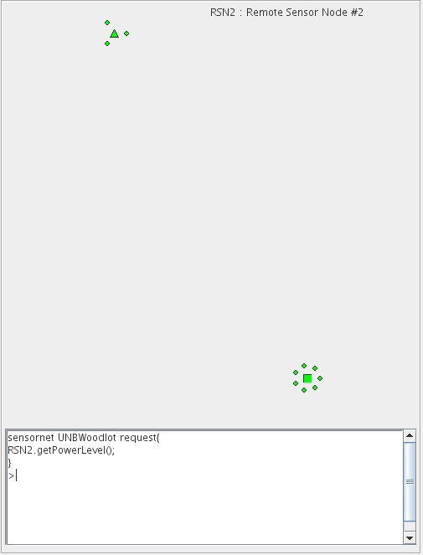



Sensor Web Language for Dynamic Sensor Networks
Gunita Saini and Bradford G. Nickerson
University of New Brunswick, Faculty of Computer Science
Motivation:
To automatically display changes in Wireless Sensor Network (WSN) to the web.
Objectives:
Current Wireless Sensor Network can be seen and queried from any browser.
Perform lab tests, by turning sensor nodes on and off.
Sensor Web Components – Dynamic Communication
Tier 4
clients
Internet
A New Node with
4 sensors attached
Tier 3
SWL Msg
A portion of Adaptive Sensor Web Language (SWL) grammar
base
station
database
New Node starts sending
SWL Msg to the base station
via gateway or a nearby
node already in WSN.
…
15. RequestAnnounce ::= {Identifier .ga();}
16. Response ::= ResponseConstructor | ResponseArrayCon |
ResponseArrayValue | ResponseConfig |
ResponseAnnounce
17. ReponseConstructor ::= {Identifier.IdRest ([Param ]);}
18. ResponseArrayCon ::= {ArrayRef.IdRest ([Param ]);}
19. ResponseValue ::= {Identifier.IdRest = Exp ;}
20. ResponseConfig ::= {Configuration {{varDecl }* {Exp }*}}
21. ResponseAnnounce ::= {nid={Hexdigit}+16;lt={N|S}deg,min,sec
;s={IntegerType};ln={E|W } deg,min,sec
;n={IntegerType}(;SID={Hexdigit +})} |
{NodeConfig }
22. NodeConfig ::= {Configuration{{varDecl}*{Exp }*}}
...
49. deg ::= {Digit }+2
50. min ::= {Digit }+2
51. sec ::= {Digit}+5
…
SWL Msg
2. Base station sending
RequestAnnounce msg. to
the new node in WSN via
the gateway
Tier 2
Wireless transit
network
SWL Msg
3. Node sending
ResponseAnnounce
message to the base station.
gateway(s)
Tier 1
SWL Msg
4. ResponseAnnounce+ sent by the base station to the web browser
New Node
Node already
In the WSN
Wireless Communication
Wired
Communication
sensor network
ResponseAnnounce message payload - 22 bytes, total size of the ResponseAnnounce message is 28 bytes sent from the sensor node to the base station.
UUID is the Universally unique identifier, unique
throughout the SWL. n is the total number of sensors
attached to the node. Message size of ResponseAnnounce
message is 3+n.
Communication between the web browser, base station and a new sensor node in Wireless Sensor Network (WSN), sequence diagram
NodeUUID
Node Latitude
Session ID
Node Longitude
n
Sensor UUID1
…
Sensor Node, s1
Base station
Sensor UUIDn
Web
Browser
Sample format of ResponseAnnounce message
Sample SWL Browser screen
New node s1, starts communication with the gateway and the base station
S1.t()
Send network
response{
nid=46f52dc76c6042319;
lt=N45,94,599999;s=97;
ln=W66,63,339128;n=3;
SID=c6cf046dc1fa4e638;
SID=cfdf449efd554fe0b;
SID=391e816927484bcbb;
}
S1 unknown,
Request Announce
Sent the latest network
S1.ga()
Response
Announce()
Ack()
Send network
Sent the latest network,
with new node s1
Sent from the new node in WSN and collected by the base station.
Proposed Sensor Observation Service (SOS) interface with Dynamic SWL
SWL
Browser
Sponsored By:
SOS Messages
SWL
Messages
SOS Consumer
SOS
Messages
SOS
SWL Server
Triangle represents a sensor node, circles represent the sensor(s) attached to the node and rectangle represents the gateway.
Database

