Slide 1
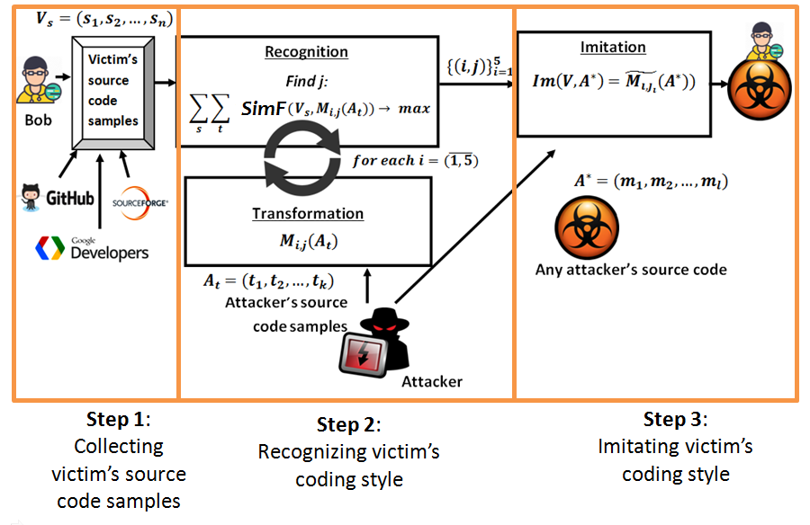
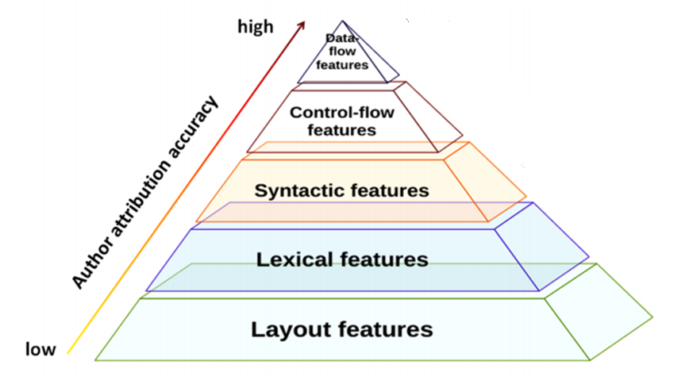
Attacking developer’s identity in open-source projects
Alina Matyukhina, Mila Dalla Preda, Celine Perley , Natalia Stakhanova
Canadian Institute for Cybersecurity, University of New Brunswick
Dipartimento di Informatica, University of Verona
CIC
ABSTRACT
Open-source software is open to anyone by design, whether it is a community of developers, hackers or malicious users. Authors of open-source software typically hide their identity through nicknames and avatars. However, they have no protection against author attribution techniques that are able to create software author profile just by analyzing software characteristics. In this work the attack scenario was created. We are able to imitate near half of the developers from GitHub. To resist to this attack author style obfuscation was developed.
Author imitation attack
Feature selection levels in software authorship
Attribution accuracy after author imitation attack
Dataset | Ding | Caliskan | DingCaliskan | TFunigrams | All
GoogleCodeJam | 4.12% | 60.32% | 63.23% | 100% | 61.34%
GitHub | 6.12% | 46.93% | 48.97% | 91.83% | 46.93%
Dataset Contents
Attribution accuracy after author protection
Feature set | Num. of author | Sample/ author | L O C | Total | info-gain | Layout | Lexical | Synta ctic | Accuracy
Original work
Ding [25] | 76 | 6 | 250 | 56 | - | 16 | 40 | 0 | 74.83%
Caliskan [25] | 250 | 9 | 70 | 120000 | 928 | 6 | 52797 | 67197 | 96.83%
Caliskan [6] | 62 | 4 | 70 | - | - | - | - | - | 97%
 | GoogleCodeJam dataset
Ding [25] | 49 | 4 | 101 | 56 | - | 16 | 40 | 0 | 70.92%
Caliskan [6] | 49 | 4 | 101 | 17522 | 490 | 6 | 8466 | 9051 | 100%
DingCaliskan | 49 | 4 | 101 | 9115 | 361 | 16 | 40 | 9059 | 100%
TFunigrams | 49 | 4 | 101 | 8439 | 137 | 0 | 8439 | 0 | 96.94%
All | 49 | 4 | 101 | 17578 | 504 | 22 | 8506 | 9051 | 100%
 |  | GitHub dataset
Ding | 41 | 6 | 567 | 56 | - | 16 | 40 | 0 | 42.28%
Caliskan | 41 | 6 | 567 | 190715 | 478 | 6 | 73351 | 117358 | 60.16%
DingCaliskan | 41 | 6 | 567 | 117414 | 367 | 16 | 40 | 117358 | 58.94%
TF unigrams | 41 | 6 | 567 | 73333 | 110 | 0 | 73333 | 0 | 48.37%
All | 41 | 6 | 567 | 190771 | 582 | 22 | 73391 | 117358 | 67.48%
Author protection method | Ding | Caliskan |  | DingCaliskan |  | TFunigrams | All
 | GoogleCodeJam
Origin | 70.92% |  | 100% |  | 100% | 96.94% | 100%
HideByCosine | 0% |  | 77.5% |  | 24.48% | 6.12% | 24.48%
MaxiCode | 2.54% |  | 77.5% |  | 27.04% | 10.02% | 31.2%
MiniCode | 3.57% |  | 75.51% |  | 28.57% | 10.02% | 29.3%
 |  |  | GitHub dataset
Origin | 42.28% |  | 60.16% |  | 58.94% | 48.37% | 65.85%
HideByCosine | 0% |  | 7.32% |  | 5.12% | 0% | 4.32%
MaxiCode | 0% |  | 4.32% |  | 5.12% | 0% | 6.32%
MiniCode | 0% |  | 7.32% |  | 7.32% | 2.43% | 6.32%
.
Conclusion and Future Works:
We showed that existing attribution techniques are susceptible to author imitation attacks: 60.32% of the authors on GoogleCodeJam and 46.93% of the authors on GitHub were successfully imitated
To mitigate author imitation attack, we proposed author obfuscation: the likelihood of identifying the author’s style was reduced from 70.92% to 0%
Explore control-flow transformations to imitate and protect author’s style

