Slide 1
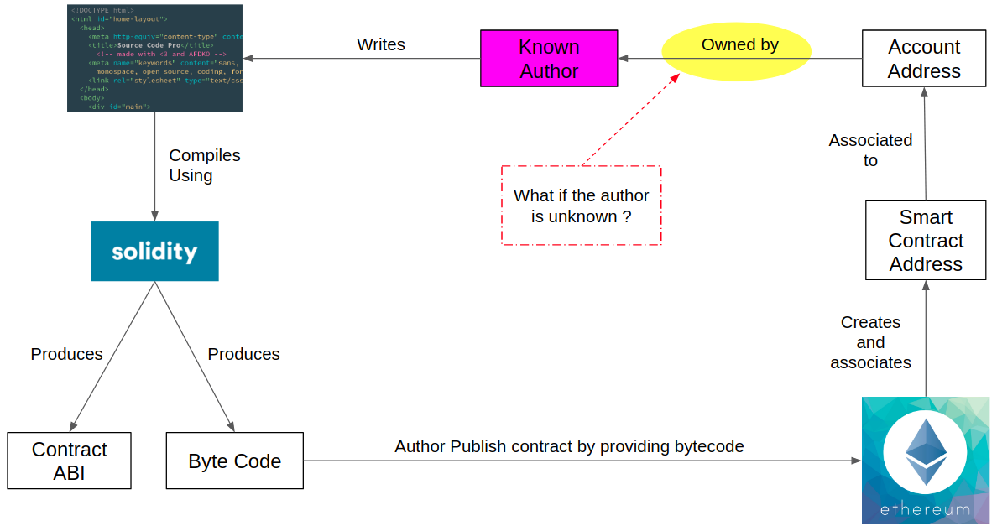
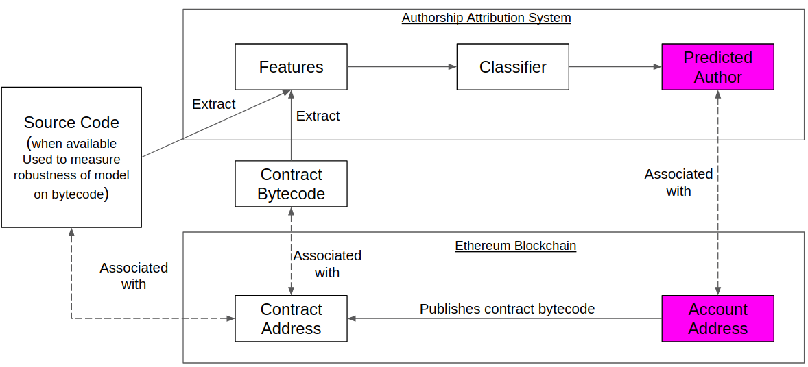
Identifying smart contract users by analyzing their coding style
Alina Matyukhina, Shlomi Linoy, Nguyen Cong Van, Rongxing Lu, Natalia Stakhanova
Canadian Institute for Cybersecurity, University of New Brunswick
CIC
ABSTRACT
In blockchain, users are identified by user accounts (account address only). An attacker wishing to de-anonymize its users will attempt to construct a one-to-many mapping between a user and an account addresses and associate information external to the system with the users. Blockchain tries to prevent this attack by storing the mapping of a user to their account addresses only where each user can generate as many account addresses as required. This project seeks to better understand the traceability of smart contracts owners (authors) and, through this understanding, explore the possibility of de-anonymizing the smart contract owners by their coding style using authorship attribution techniques. If the likability of two different smart contract addresses to the same user is possible, the adversary can use such techniques to link all the agreements, transactions that these addresses participate in, therefore it is a serious threat on smart contract users anonymity.
Research Problem
Previous research
Related work | Number of authors | Number of features | Accuracy
Source code attribution
Dauber et al. | 106 | 451,368 | 73%
Caliskan et al | 1600 | 120,000 | 93%
Binary code attribution
Alrabaee et al. | 10 | 6,500 | 80%
Caliskan-Islam et al. | 600 | 4,500 | 83%
Rosenblum et al. | 190 | 10,000 | 95%
Our Approach
Dataset Contents
Dataset | Keys | Contracts | Av. contracts/key | Min contracts/key | LOC
Set A | 585 | 4834 | 8 | 4 | 394.67
Set B | 5086 | 65624 | 11 | 4 | 124.59
Description of feature set
.
LEVEL | FEATURE | DESCRIPTION
Source code | TF unigrams | Term frequency of word unigrams in source code after tokenization the code
 | AST features | Derived from abstract-syntax tree (max depth of AST, etc.)
 | Layout features | Type of comments, type brackets, spaces (tabs), lines
Bytecode (opcode) | Idioms | Short sequences of instructions intended for capturing stylistic characteristics
 | CFG graphlets | 3-node subgraphs of the CFG (control-flow graph)
 | CFG supergraphlets | Obtained by collapsing and merging neighbor nodes of the CFG
 | Libcalls | Function names of imported libraries
 | N-grams | Short sequences of opcode of length N
Results
Data | Number of keys | Number of contracts | Type of features | Number of features | After info gain | Classifier | Accuracy
Source code | 585 | 4834 | TF unigrams | 143200 | 1275 | Random Forest | 75.88%
Contract ABI | 585 | 4834 | TF unigrams | 18944 | 31 | Random Forest | 58.56%
Contract opcode | 585 | 4834 | TF unigrams | 44504 | 44 | Random Forest | 62.7%
Conclusion and Future Works:
We obtain more than 75% accuracy after classification authors of Solidity
source code and more than 60% on bytecode by easy-to-extract features- TF unigrams
Further study on the features extracted from AST and CFG
Clustering contract accounts by their users

