Slide 1
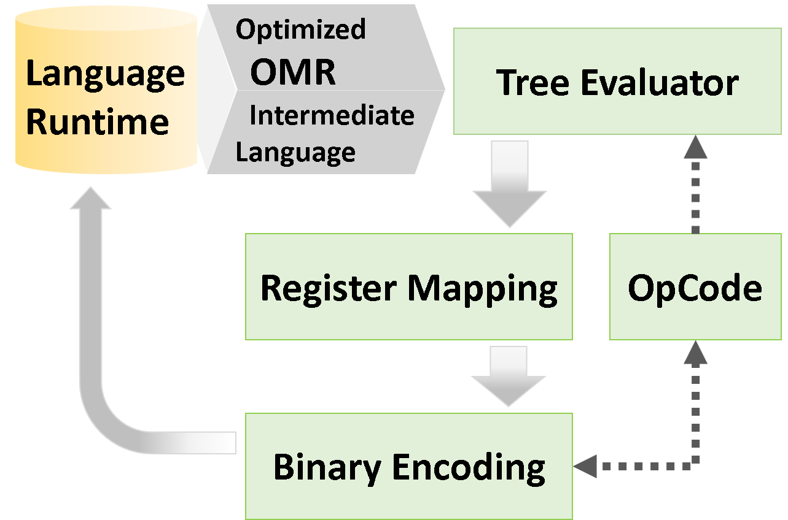
AArch64 Support for the OMR Language Runtime Toolkit
Md. Mahbubur Rahman, Hillary J. Soontiens,
Jean-Philippe Legault, Aaron G. Graham, Kenneth B. Kent
University of New Brunswick, Faculty of Computer Science
Daryl Maier, Kazuhiro Konno
IBM
{mrahma15, hsoontie, jlegault, aaron.graham, ken}@unb.ca,
{maier@ca, konno@jp}.ibm.com
OMR Backend
Progress
Initial interface with the AArch64 platform complete.
Necessary infrastructure exists to call out to the binary code for AArch64.
The OMR Toolkit includes all the equivalent OpCodes and binary encoding from the AArch64 architecture.
OMR IL “return 3” function passes through the entire flow.
Register allocation functionality, signal handling, port library and system calls have been included for “return 3”.
Basic functionality exists for virtual register allocation, assignment and mapping.
Most of the Tree Evaluators have been implemented, along with tril tests that pass manual invocation.
Optimization of some existing Tree Evaluators has been done.
The OpenJ9 VM port to AArch64 is complete.
Future
Implementation of the JIT runtime.
Implementation of Tree Evaluators for OpenJ9.
Enabling builds of OpenJDK and OpenJ9 on JDK11.
Trampoline support must be added for AArch64 in OpenJ9.
Background
Eclipse OMR: An open source Toolkit of C and C++ components that can be used to build robust language runtimes to support many different hardware and operating system platforms.
ARM: A family of CPUs based on the RISC instruction set.
AArch64: A subset of ARM based on a 64-bit architecture.
Motivation
Better Hardware Footprint, Power Usage and Heat Management
ARM System on Chip (SoC) devices offers easier product development.
ARM has been targeting mobile and battery powered devices for years, making them an obvious choice for decreased power consumption.
ARM SoCs are easier to confine in closed spaces and have easier heat management.
Lower Cost to Buy and Maintain
Open design of ARM chips allow many manufacturers to make SoCs; lowering costs for the end user.
The SoCs, having such a low price point to manufacture, are almost disposable.
A stateless design allows for rapid scaling in server infrastructure.
Easier Hardware Implementation
Open design allows manufacturers to create more complex chips with more features.
Porting OpenJ9 + OMR to the ARM, AArch64, architecture would allow a plethora of devices to gain from each of the runtime optimizations already inside OMR and those yet to come.
Notes:
1

