Slide 1
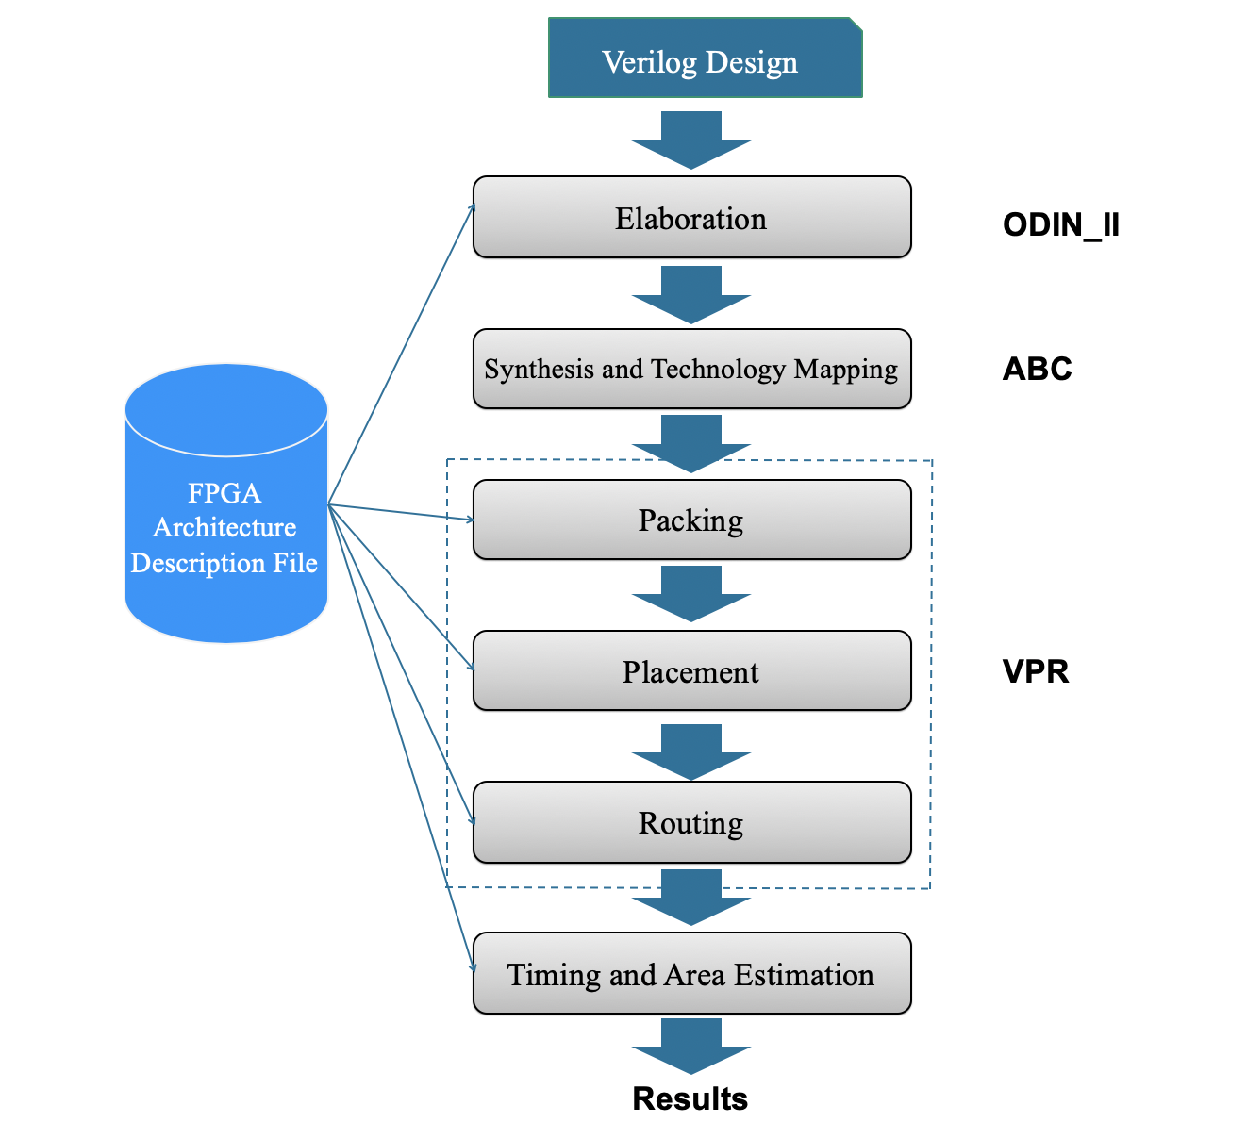
Improving the Verilog-to-Routing
FPGA CAD Flow
Nasrin Eshraghi Ivari, Kenneth B. Kent
Faculty of Computer Science, University of New Brunswick
nasrin.Eshraghi@unb.ca, ken@unb.ca
Verilog-to-Routing CAD flow
Progress
Improve the Verilog language feature coverage of the ODIN_II compiler within the Verilog-to-Routing tool.
Investigate System Verilog, an extension of the Verilog Hardware Description Language
Improve memory usage, quality of results and execution time for ODIN_II
Future Work
Optimization of elaboration performance
Enhance elaboration visualization tool
Incorporating new benchmarks into the Verilog-to-Routing regression flow
Full support of Verilog 2005 language specifications to ODIN_II to be finished at the end of September 2020
Background
Verilog-to-Routing project: is the world-wide collaborative project to provide an open-source framework for conducting FPGA architecture and CAD research and development. The VTR design flow consists of three component applications: ODIN_II, ABC and VPR.
FPGA: A Field-Programmable Gate Array (FPGA) is an integrated circuit that can be configured by the user to emulate any digital circuit as long as there are enough resources.
ODIN_II: Performs logic synthesis and elaboration, converting a subset of the Verilog Hardware Description Language into a BLIF netlist. ODIN_II development is led by the University of New Brunswick.
Improving the CAD flow is a collaborative project between HUAWEI, University New Brunswick, University of Toronto and Waterloo University.
Motivation
Next generation mobile phones with FPGAs
High performance computing
Handle IoT part easily in smart phones
Ideal for real time applications
High security
High reliability
Flexible management
FPGA architecture advantages
FPGA does not have a fixed hardware structure, it is programmable.
Parallel processing usage such as video processing
Process large data with few clock cycles
Signal processing such as digital filtering, demodulation, detection algorithms, image processing
Notes:
1

