Slide 1
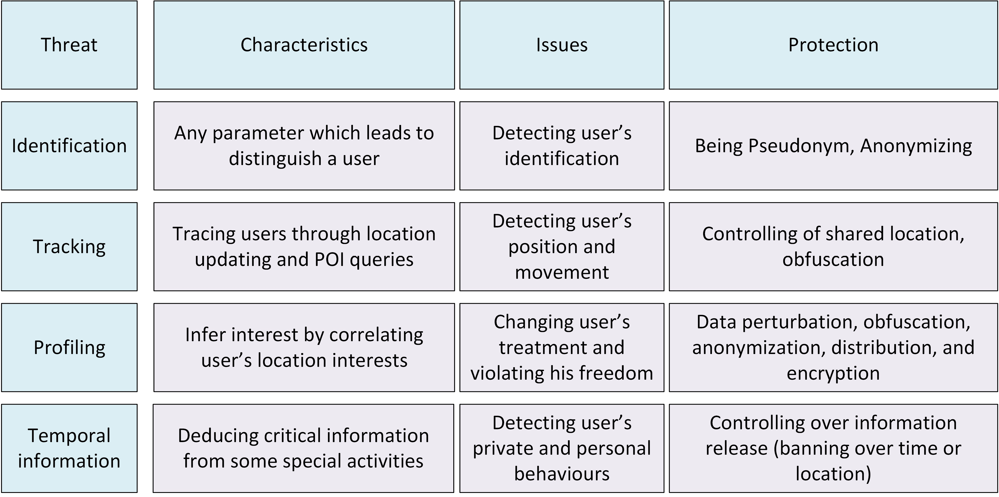
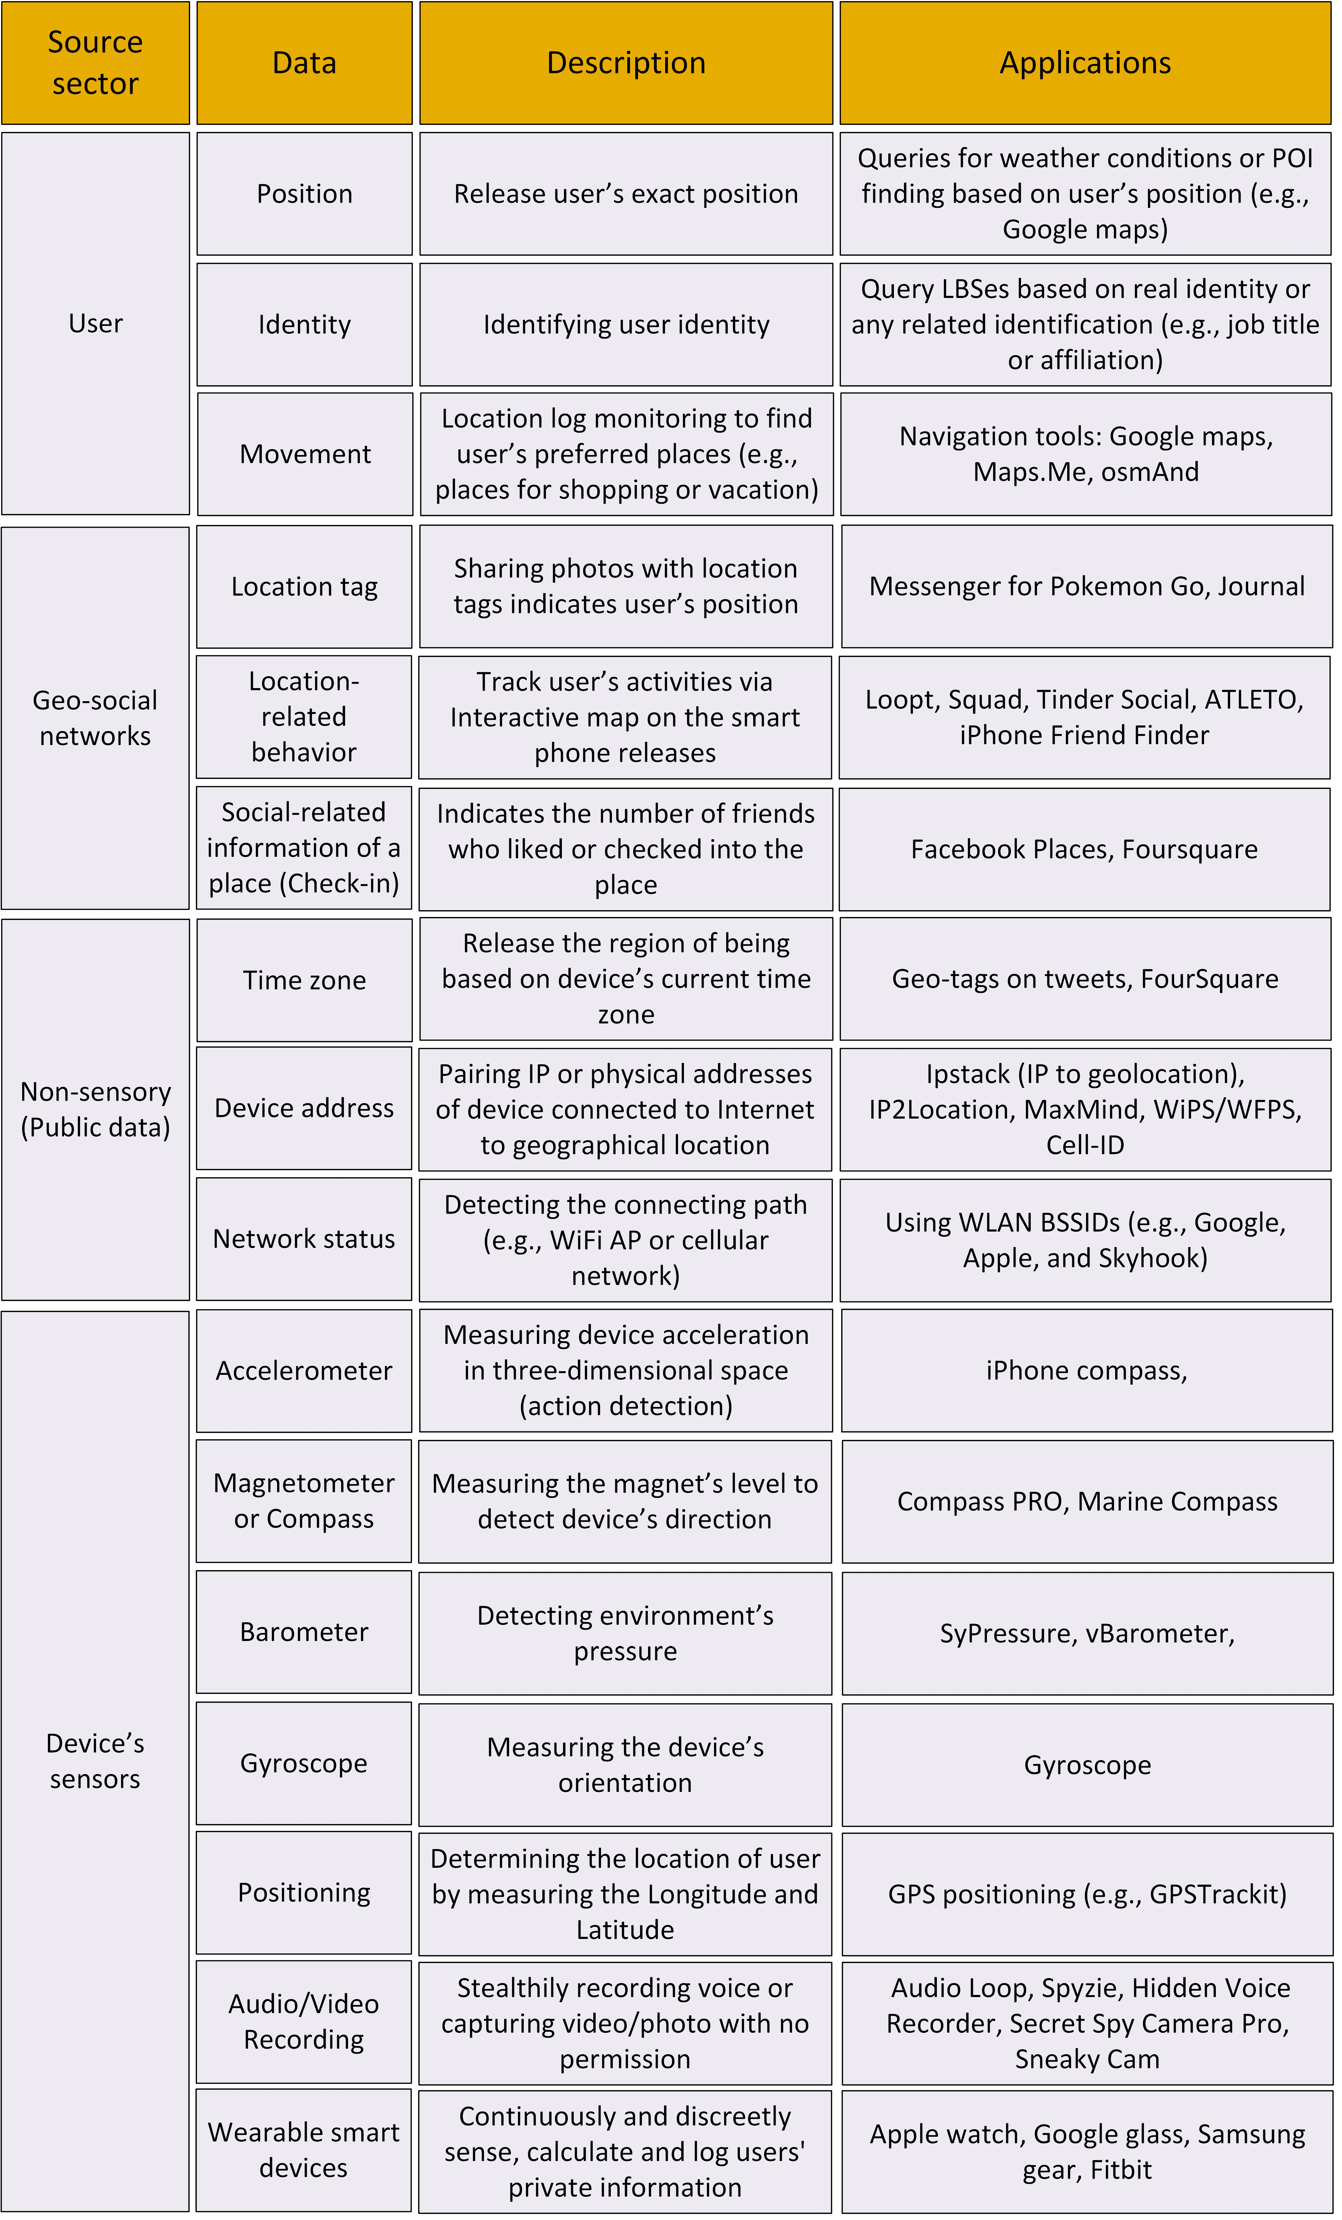
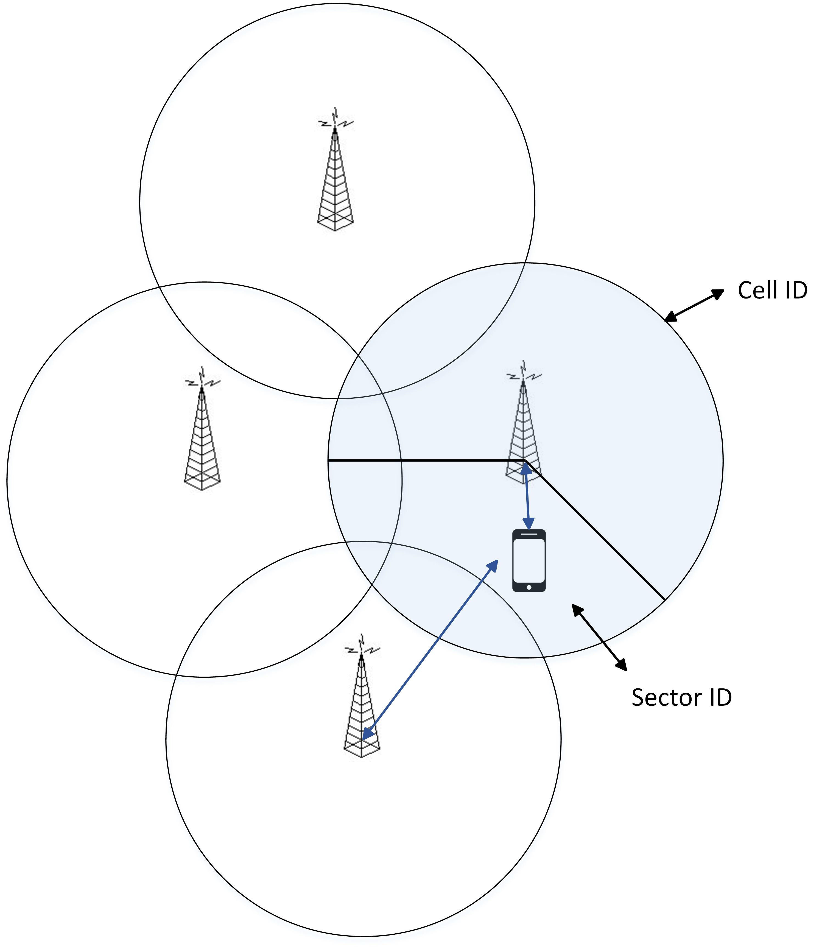
Location Privacy issues with the online Services
Mahdi D. Firoozjaei and Ali A. Ghorbani
Contact Email: m.daghmechi@unb.ca
Canadian Institute for Cybersecurity (CIC), University of New Brunswick (UNB)
CIC
ABSTRACT
Table 1. Privacy issues with location information in LBSes
Growing and extensive dependency to location information in the online services, e.g., location-based services (LBSes), open a variety issues of security and privacy due to abuse feasibility and unreliability of untrustable service providers. Financial benefits of users' location information can be seen in some industries like tourism, marketing, mobile commerce, information and emergency services, or even in terrorism and black marketing. Almost all medium and large organizations collect and store location data. Based on the recent report of the state of location intelligence [1], 54% of business managers believe their business collect location data using mobile devices or online applications. Determining user’s position, location-related behavior, real-time movement, geo-social treatments, and profiling are some examples for possible threats of location security and privacy. Understanding the possible location security and privacy issues helps to protect user’s information in the online applications. We provide an overview of the possible issues with user’s location security and privacy. Furthermore, we classify the possible location information disclosure which violates user’s location privacy.
[1] https://carto.com/state-of-locationintelligence-2018/
Table 2. Possible ways to disclose user's location information
2. Security and Privacy issues in LBSes
Basically, the location information in LBSes is not just a set of coordinates or the name of a place. It may also include more information about user, like identity, spatial information (position), and temporal information (time). Based on this, the security and privacy issues can be considered in a triple view of (identity, position, time). The security and privacy issues related to user's location information in LBSes can be classified as shown in Table 1.
3. Location intelligence
Location intelligence (LI) is a concept of business intelligence (BI) and involves data points over layed on an interactive map interface for easy referencing. By adding more layers of data, LI provides visualized map required for geo-marketing, area analysis, and geographic demographics. Due to financial reasons, geographical information systems (GIS) collect LI from user’s activities in the social network and other emerging Internet sensors [2, 3]. Logging user's posted contents in the social networks, on-lone browsing, and shopping queries are used to improve LI features.
.
[2] M. Koohikamali, M. Mousavizadeh, and D. Peak. Continued Usage and Location Disclosure of Location-Based Applications: A Necessity for Location Intelligence.
In 52nd Hawaii International Conference on System Sciences, HICSS-52, 2019.
[3] C. Weidemann and J. Swift. Social Media Location Intelligence: The Next Privacy Battle - An ArcGIS add-in and Analysis of eospatial Data Collected from Twitter.com. International Journal of Geoinformatics, 9(2):2127, 2013.
4. Location information disclosure
The possible ways to disclose user’s location information are classified in Table 2. This information can be released by user, geo-social networks, public information, and the sensory data available in user’s smart devices. User directly discloses his/her location information while exploiting LBS applications. Any posted content in the social networks is more than a context or photo. Normally, the attached timestamp, geo-tag, or tagged others name reveal more details about user's privacy. User's geographical actions are logged by geo-social networks to model human behavior.
The sensors available on user's device indirectly disclose more information related to user's geographical position. Long term monitoring makes it possible to profile a user's long-term privacy. Accelerometer, gyroscope, barometer, magnetometer/compass, and GPS receiver are exploited to detect user’s location information and profiling. For instance, Recognizing user's physical patterns (e.g., walking manner) by device's sensors is a solution for user's positioning.
Moreover than the sensory data, publicly available and non-sensory data, like time zone, IP and MAC addresses, and network status disclose user’s location information. For example, Fig. 1 shows an example of positioning a mobile terminal in the sort of Cell-ID and Sector-ID
Fig 1. Network-based positioning
by Cell-ID and Sector-ID

