Slide 1

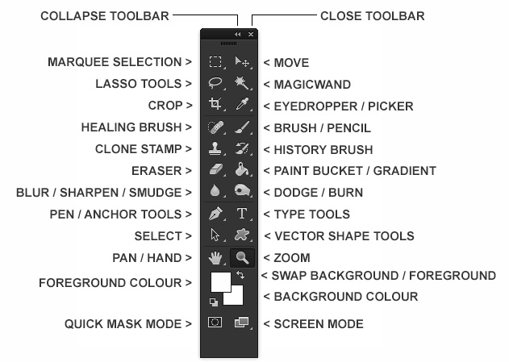
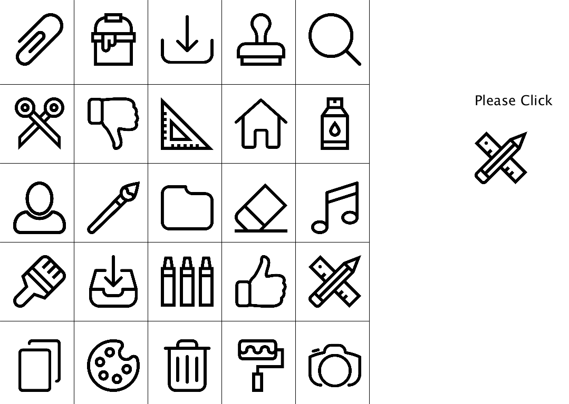
Artificial Landmarks for Spatial Interfaces
Vedang Goswami, Scott Bateman
Faculty of Computer Science
Overview
Interfaces that leverage spatial organizations to access commands in an interface are known to be faster than familiar alternatives such as menu based organizations. This is because people’s spatial memory allow for effortless learning of command location (see the image on the left).
However, as the number of commands in an interface grows, it becomes more difficult to learn command locations. In non-computing scenarios, spatial learning benefits greatly from landmarks in the environment, but user interfaces often provide very few visual landmarks. In this work, we evaluate the addition of simple landmarks to learning command location in spatial interfaces.
Figure 1. An example of a real world spatial interface in Adobe Photoshop.
Experiment
We check how artificial landmarks (anchors) can be useful to improve a user’s spatial memory. The experiment asks user to select specific item from spatially-stable grid icons in two interfaces: With or Without Artificial Landmarks.
Figure 2. The experimental system without Artificial Landmarks.
Figure 3. The experimental system with Artificial Landmarks.

