Slide 1
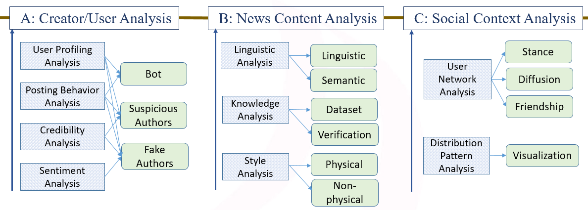
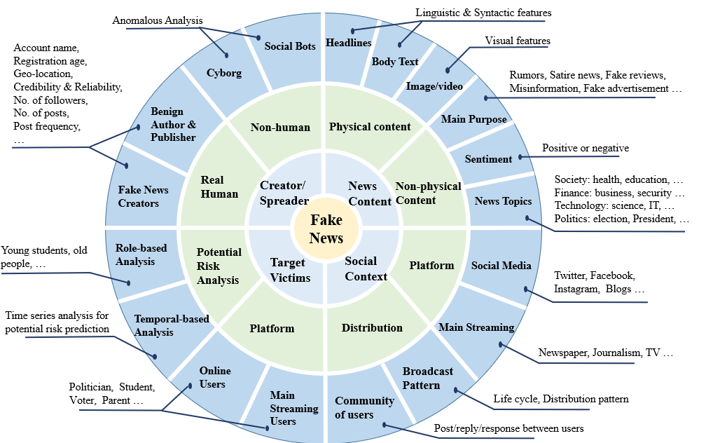
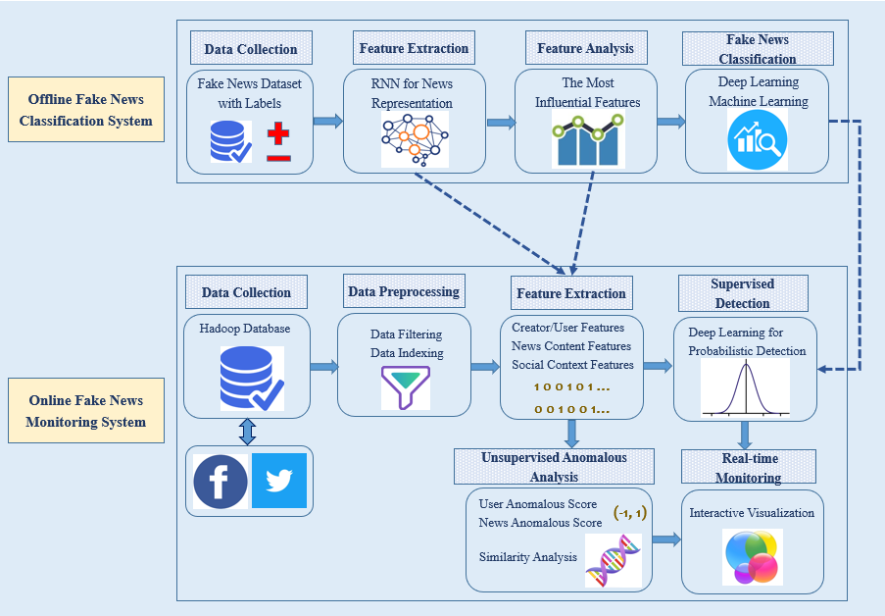
An Overview of Online Fake News: Characterization, Detection, and Discussion
Xichen Zhang, Ali A. Ghorbani
Contact Email: xichen.zhang@unb.ca
Canadian Institute for Cybersecurity (CIC), University of New Brunswick (UNB)
Published in “Information Processing & Management” on 20 March, 2019
CIC
OBJECTIVE
Over the recent years, the growth of online social media has greatly facilitated the way people communicate with each other. Users of online social media share information, connect with other people, and stay informed about trending news. However, much recent information appearing on social media is dubious and, in some cases, intended to mislead. Such content is called fake news. Large amount of online fake news has the potential to cause serious problems in society. By conveying biased and false information, fake news can destroy folk’s faith and beliefs in authorities, experts and the government. There is even a view that Donald Trump’s victory in 2016 U.S. president election is somehow regarded as the outcome of fake news. As fake news detection has become an emerging topic, more and more giant companies are seeking future solutions for recognizing online false information, i.e., the “Google News Initiative” program announced by Google. In this study, we discuss the in-depth understanding of the important aspects of online fake news, then list an exhaustive set of hand-crafted features for fake news identification. Also, some interesting and potential research area are proposed in order to address the open issues.
CHARACTERIZATION
FAKE NEWS DETECTION
PROPOSED ECOSYSTEM
Online Fake News Definition:
(1) Authenticity (2) Intention
Include false information, ads, reviews, stories, rumors that purposely mislead online readers
Fig. 3 Research analysis for fake news identification
Features for Fake News Representation
User-based Feature | Content-based Feature | Context-based Feature
User Profiling | Linguistic Pattern | Interaction Network
User Credibility | Writing Style | Impact Information
User Behavior | Visual Information | Temporal & Spatial
e.g., account name, geolocation, age, number of friends, Number of followers, … | e.g., n-gram, bag-of-words, suspicious items, sentiment words, part-of-speech tagging, semantic embeddings, … | e.g., in-degree/out-degree of the interaction network, frequency/intensity of online activities, time interval between each actions, …
Fig. 5 The proposed ecosystem for fake news altering, detection, and intervention
.
The proposed ecosystem:
Alert Layer (before fake news happens): detect potential & suspicious news creators/spreaders, friends, and sensitive topics
Detection Layer (during fake news happens): identify fake news and fake news creators on both online social media and main streaming platform with predefined features.
Intervention Layer (after fake news happens): try to mitigate the negative impacts of fake news by intervention.
Fig. 1 An onion-based graph for fake news characterization
Aspects of Online Fake News:
News Creators: Malicious & Benign Creators
News Victims: Direct & Indirect Victims
News Content: Physical & Non-physical Content
News Social Context: Platform & Distribution
Table 1. Different features for fake news representation
FUTURE DIRECTIONS
The promising research directions
Unsupervised Learning: due to the limited accessibility of high-quality and real-time dataset.
Cluster Analysis
Outlier Analysis
Semantic Similarity Analysis
Unsupervised News Embedding
One-class Classification: The real-world social media dataset is a good resource for training one-class classification models.
Real-time Visualization: Visualization can provide diverse dimensions and views of the data, facilitate human understanding and supervision, reveal temporal and spatial-based patterns, and present important features in a more clear way.
Fig. 4 Offline and Online Fake News Detection Systems
Offline & Online Systems:
Offline System: aims to understand dataset, influential features, and learning models.
Online System: aims to provide real-time/world monitoring for potential fake news distribution.
Fig. 2 An example of fake news distributed in Facebook

