Slide 1
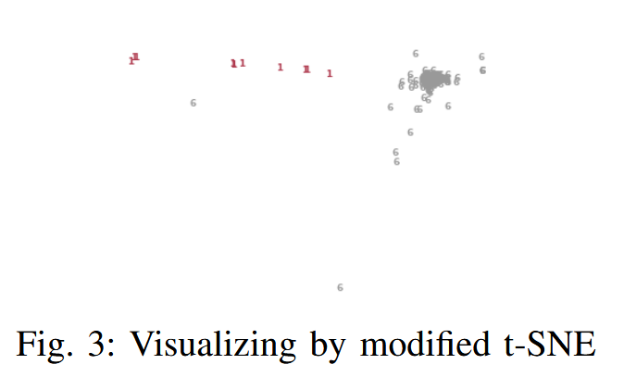
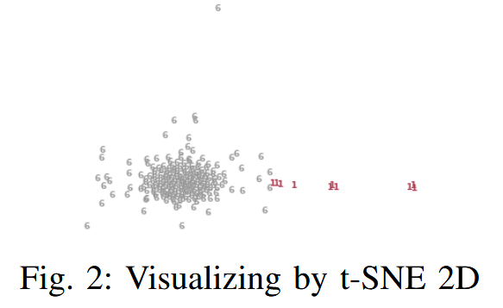
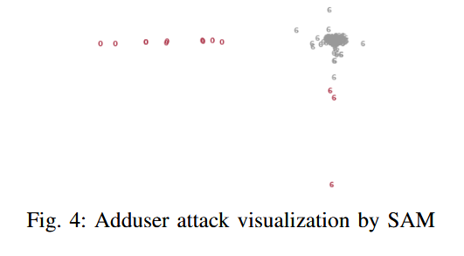
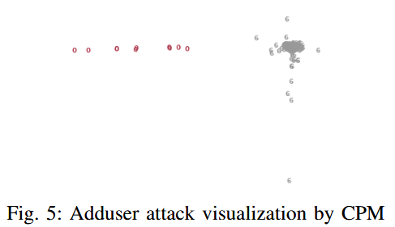
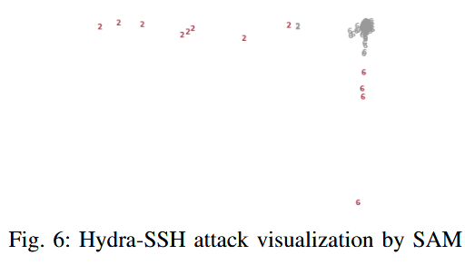
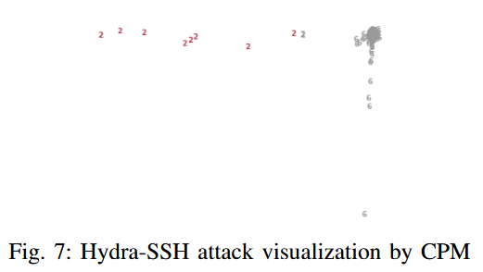
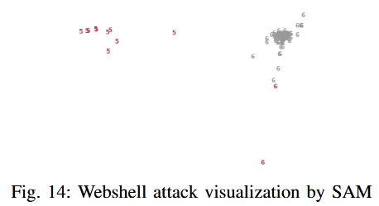
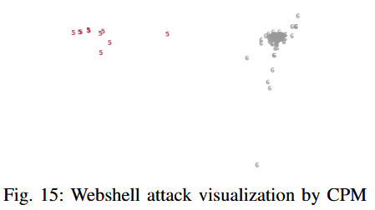
A Novel Visual Anomaly Detection Method
Iman Sharafaldin and Ali A. Ghorbani
Canadian Institute for Cybersecurity (CIC), University of New Brunswick (UNB)
CIC
ABSTRACT
We propose a novel visualization technique (Eagle-Eye) for intrusion detection, which visualizes a host as a community of system call traces in two-dimensional space. The goal of to visually cluster the system call traces. Although it can easily perceive anomalies using EagleEye view, we propose two different methods called SAM and CPM that use the concept of data depth to help administrators distinguish between normal and abnormal behaviors. Our experimental results conducted on Australian Defence Force Academy Linux Dataset (ADFA-LD), which is a modern system calls dataset that includes new exploits and attacks on various programs show EagleEye ’s efficiency in detecting different exploits and attacks.
Modified t-Stochastic Neighbor Embedding
Experiments
Spherical Depth
Visualizing Anomalies
.
Results:
Satisfied Area Method (SAM): In this method we define a circular area with a radius of σ and center of data depth, which is called ‘Satisfied Area.’ Thus, any point which stays out of the Satisfied Area is considered as an anomaly or attack.
Confident Partition Method (CPM): Based on our experiments we determined that if we partition the space into three sections defined by vertical lines positioned one σ away from the data depth, the majority of activities falling outside the data depth partition can be classified as attacks, and the rest can be considered as normal activities, we call this partition ’Confident Partition’.
Conclusion
In order to visualize network anomalies, EagleEye generates a 3-gram feature vector for each system call trace.
Then it visualizes the system by using a modified version oft-SNE
Next, it highlights anomalies by two proposed methods SAM and CPM.
Experimental results on ADFA-LD show that the proposed technique is an effective and practical solution for detecting unknown attacks and exploits.

