Slide 1


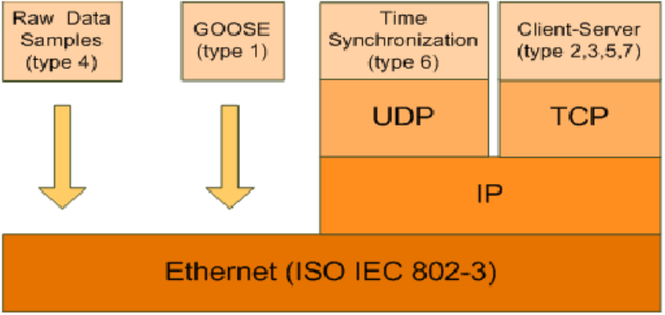
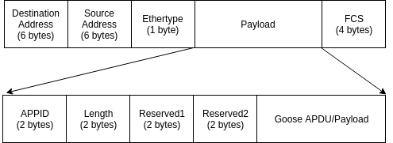
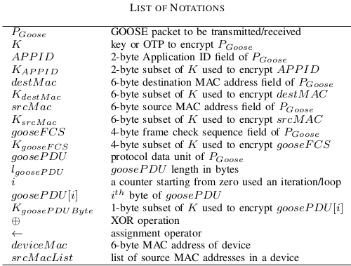
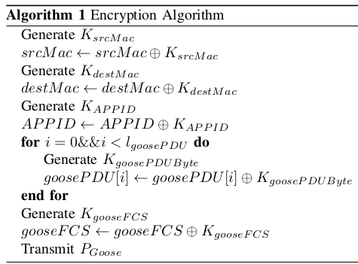
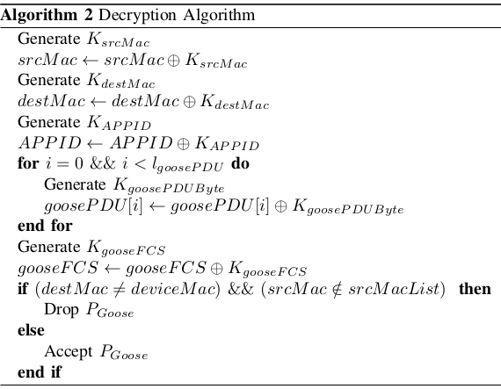
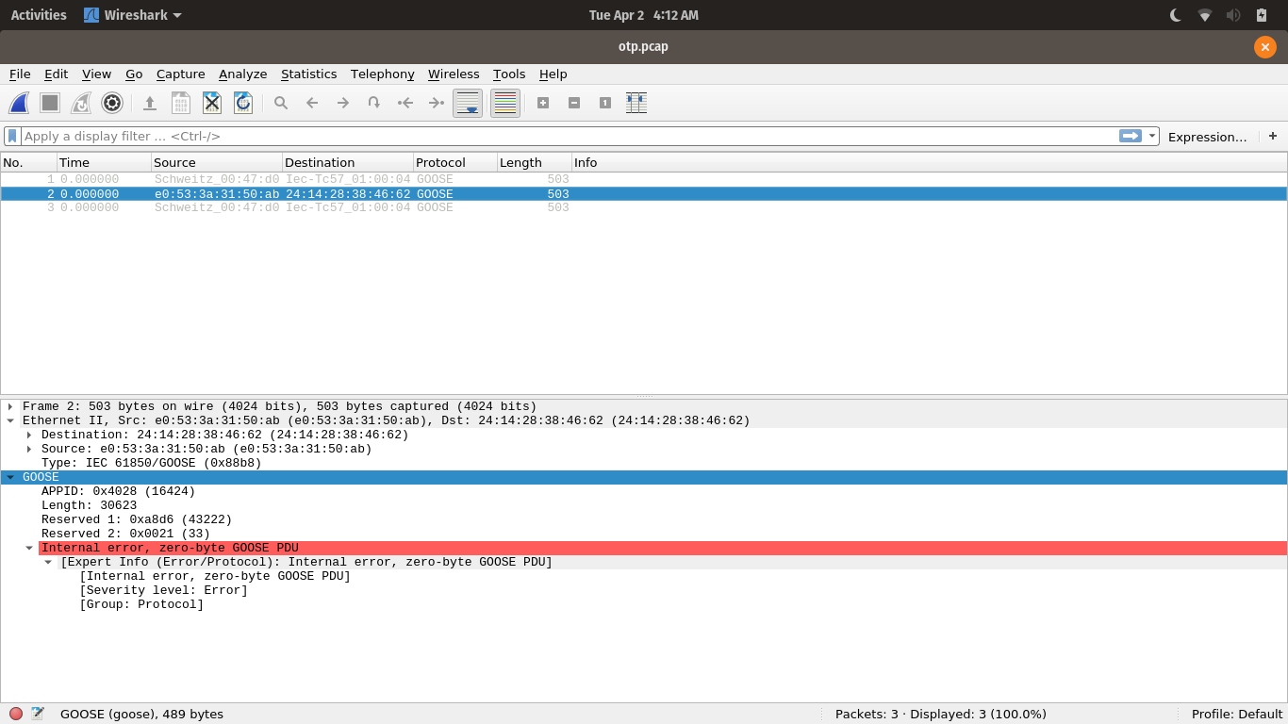
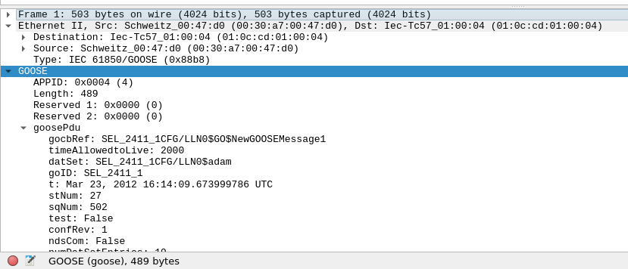
Application of One-Time Pad in Security of
Substation Automation Systems
Kwasi Boakye-Boateng, Arash Habibi Lashkari, Ali A. Ghorbani
Canadian Institute for Cybersecurity (CIC), University of New Brunswick (UNB)
CIC
ABSTRACT
IEC 61850 is an international standard that is widely used in substation automation systems (SAS) in smart grids. It abstracts data and services making them independent of any underlying protocol. And for such protocols to be implemented in SAS, they must be well-mapped to IEC 61850 data objects and services. As beneficial as this standard is, security was not taken into account when the standard was designed. This made substations vulnerable to attacks such as (distributed) denial of service, man-in-the-middle; and spoofing attacks. There is existing research that have investigated the mitigation of these attacks using intrusion detection/prevention systems and firewalls which have shown promising results. Limited research into the encryption of the packets, that are communicated within the SAS, exist due to the major challenge of time overhead for critical messages, which require a maximum delay of 4ms. This research investigates the possibility of creating and implementing a One-Time Pad-based encryption protocol for IEC 61850.
Problem
Previous Research
  Early days of IEC 61850, no security recommendations for GOOSE protocol because of implementation in an isolated and confined network with a substation.
  IEC 62531 introduced to provide security recommendations for protocols including GOOSE
  However GOOSE is not secure because of latency should be ≤ 4ms
Research | Protocol | Values | Problem
Zhang et al. | CLPKC | ≈ 1.409ms | Theoretical and difficult to be replicated practically
Premnath et al. | NTRU | > 15ms | High latency, even though implemented on Raspberry Pi
Wang et. al | Mixed RSA and DES | < 2ms | Requires high computing performance
GOOSE Packet Structure
Motivation
IEC 61850 Performance requirements
  Create an encryption protocol using One-Time Pads
  OTPs are randomly generated keys with same length as plaintext
  Encryption/Decryption: OTP XOR PLAINTEXT
IEC 61850 OSI Architecture
Proposed Protocol
.
Results:
Conclusion and Future Works:
Latency (Implemented in Python)
Encryption/Decryption with RNG ≈ 5ms
Encryption/Decryption without RNG ≈ 4ms
  Encryption of GOOSE packets possible with OTP
  Already captured GOOSE packets in pcap file were encrypted using Python script. This is due to lack of access to actual devices to implement algorithm
  High latency because packets need to be converted to integer values before XOR is possible.
  Latency will be far less if implemented on the device because of ‘raw’ nature of the packets
  Future work will be to emulate a device and substation network to test
Wireshark Display of Encrypted and Normal Goose Packets
Packet Details of Normal Goose Packets
Packet Details Encrypted Goose Packets

