Slide 1
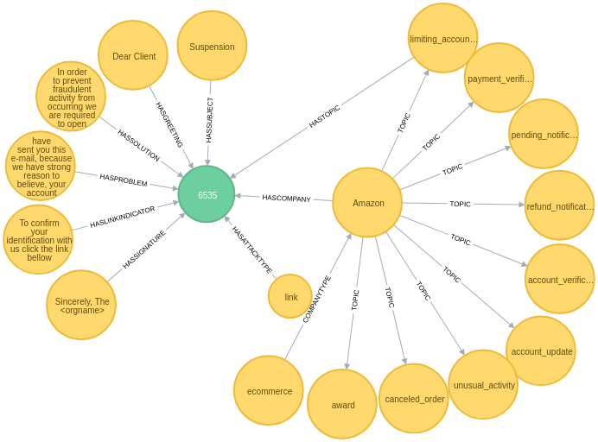
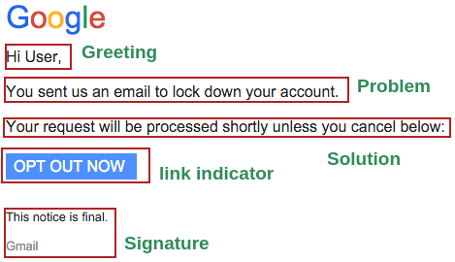
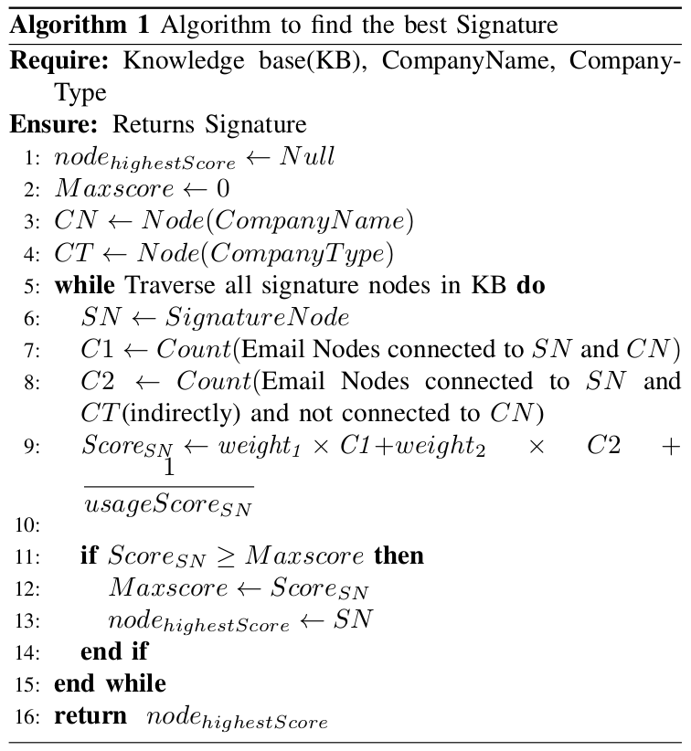
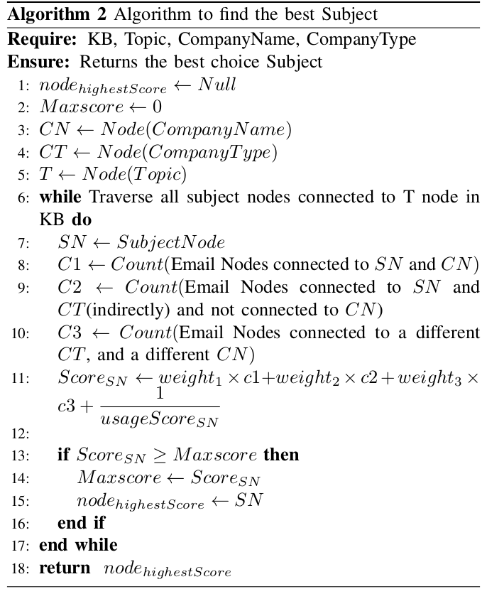
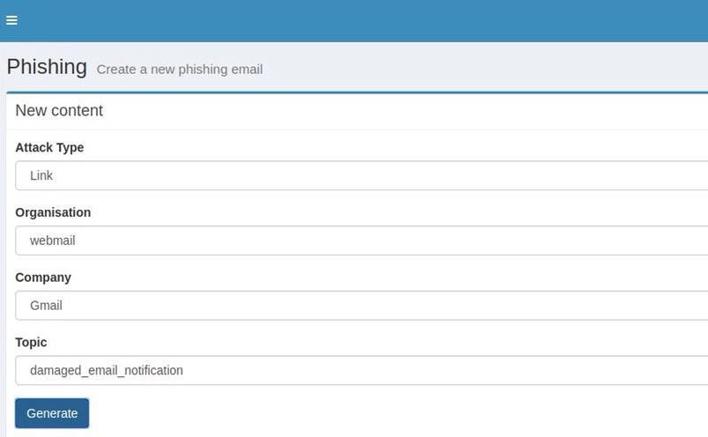
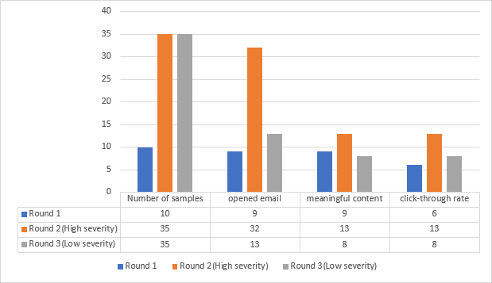
Simulating Phishing Email through Graph Database Models
Nasim Maleki, Ali A. Ghorbani
Canadian Institute for Cybersecurity (CIC), University of New Brunswick (UNB)
CIC
Abstract
We need Phishing Awareness Tools to train employees because existing anti-phishing filters are not 100% capable of detecting phishing attacks, especially zero-day attacks.
Current awareness tools can make phishing campaigns targeting the employees, but they contain an only limited number of predefined email templates.
In this work, we designed a framework and built a tool generating phishing emails automatically from a graph database perspective. Then, we conducted a three-round experiment.
We sent the automatically-generated emails to some members of our community without informing. On average, 72.85% of victims opened the emails, the click-through rate was 54.05%
among who opened the emails, and all recipients who completed the survey stated that the content of emails were meaningful.
In this experiment, we also showed which parts of the email are more luring and what the result might be if emails are carefully-crafted or from a person of authority.
Previous Research
Contributions
Research | Goal | Features | Applications
Seymour2016weaponizing | Generating Phishing Tweets | Generates spear phishing on Twitter automatically which is faster than the normal process.It generates new tweets using Markov Models and LSTMs and then targets valuable users. | Spear Phishing Simulation
Palka2015dynamic | Generating Phishing Email | Dynamic phishing content using generative grammars, It has used 30 rules in context free grammars to generate phishing email, but the number of rules are limited | Fuzzing Anti-phishing Tools
Palka2015fuzzing | Generating Phishing Email | Adding N-Gram Analysis to the previous framework Palka2015dynamic. Their original idea was avoiding repetition in e-mails for exercises using n-grams. | Fuzzing Anti-phishing Tools
We created a knowledge base from the data segments of 300 phishing attacks from APWG Dataset. They have semantic tags and weights based on the number of edges coming to or going from them.
Built a web application to generate meaningful phishing contents automatically.
Our tool can return the generated email to the knowledge base to increase the weight of its data segments. High-weighted nodes are probable to be chosen again, but data segments with the lowest weight are gradually removed from the knowledge base.
Conducted three practical experiments to show generated emails are meaningful.
In the second and the third experiments, we have shown that spear phishing attacks have different severities.
System Overview
Algorithms
Email Fragmentation
Adding the Generated Email into the Database
Insert semantic fragments in the Graph Database(knowledge Base)
.
Combining and Generating a New Email
Selecting Data Segments with the Highest Weights
Results
Round 1
Spoofing Google Drive
Spearphishing
Hidden Script in image
Round 2(severe)
Impersonating a person of authority(Director)
Invitation email to an event including an attachment
Hidden image into the email to track
Round 3(Less Severe)
Impersonating a less important sender(university gym)
General announcement to all with a fake obfuscated link
Hidden image into the email to track
Conclusion and Future Works
Phishing Attack is still a major cyber attack. Anti-phishers are not capable enough of detecting phishing attacks with 100% accuracy.
Educating people and using Phishing Awareness tools has a vital role to increase this detection rate.
In this research, to make these Awareness Tools more powerful and usable, we implemented a system to generate automatically new and meaningful phishing emails based on the topic and the company type.
Notes:
1

