Slide 1
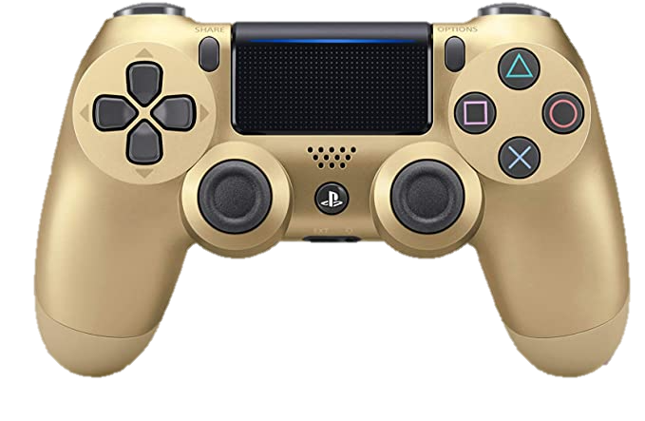
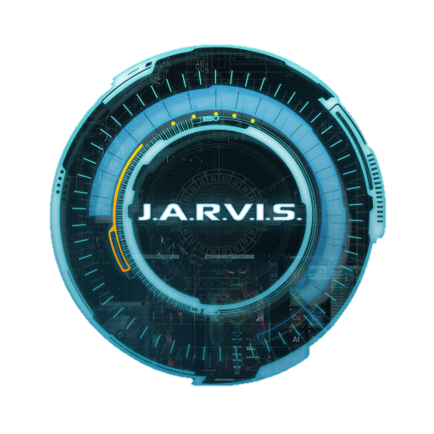
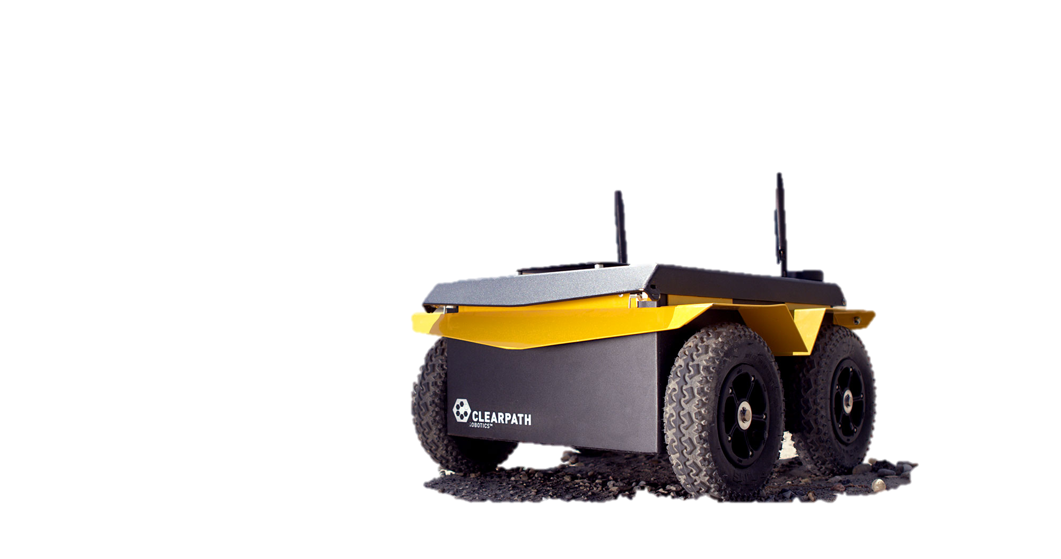
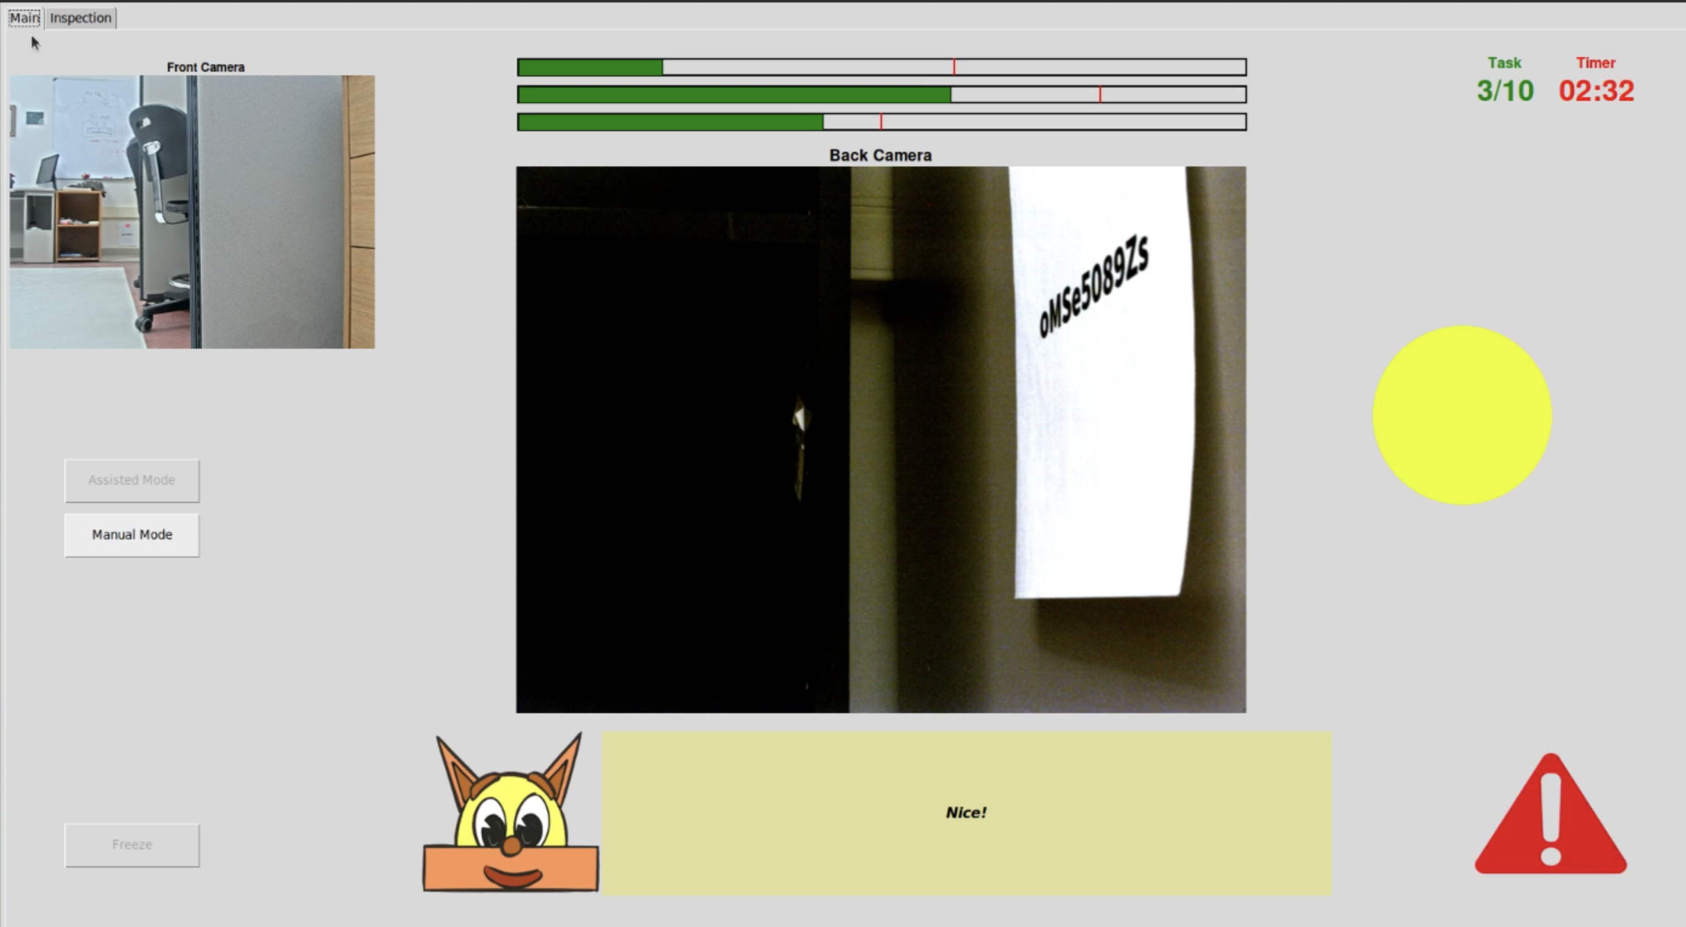
”J.A.C.K.A.L”: Your social AI Companion in robotic teleoperation
Introduction
Controlling Robots is hard
AI can help humans to do tasks
Interaction between two has challenges
Social Interfaces Example:
Cortana from Halo
JARVIS from Ironman
Companionship -> Productivity
Crux of Research
Q: How can humans trust AI more when in charge of a robot?
A: Social Interfaces can bring benefits of human-human interaction
Natural Disasters
Search and Rescue
Space Exploration
Methodology
Search and navigate task
In some situations, it gets REALLY HARD
Robot makes mistakes, but does
better than humans
Will you let the the AI handle it?
Uuh! I did some mistakes and lost 200 points. You lost 250. Together, we lost 450 points overall. I am sorry about this. I know your experiment reward might be at stake
Scores Lost: 200
LogError: Uncalibrated sensors.
LogWarning: System loss: 200. User loss: 250. Total loss: 450. Experiment Reward at stake.
Social
Interface
Non-Social
University of New Brunswick HCI Lab | hci.github.io Daniel J. Rea Pouya Pournasir {daniel.rea, pouya.pournasir} @ unb.ca

Slide 2
Controlling Robots is hard
AI can help do tasks for humans
Humans and AI both controlling robots can make it easier
Still a challenging dynamic:
Workload
Decision Making
Etc.
Our research question: How can humans trust AI more when both in charge
Our Solution: Social Interfaces can bring benefits of human-human interaction

